Slide 1




Characteristics of Degree of Compaction and Stiffness of Two Different Embankment Slopes:
A Case Study
Dr. Suman Manandhar, Tribhuvan University, Nepal
Noriyuki Yasufuku, Kyushu University, Japan
Ranjan Kumar Dahal Tribhuvan University, Nepal
Mitsuru Taniyama, Asakawagumi Co., Japan
Assistant Professor,
Geodisaster Research Center, Central Department of Geology, Tribhuvan University, Kirtipur, Kathmandu, NEPAL
Visiting Faculty,
School of Engineering, Department of Civil & Geomatic Engineering, Kathmandu University, NEPAL
Visiting Associate Professor
Institute of Lowland and Marine Research (ILMR), Saga University, JAPAN
Secretary General cum Treasurer
International Association of Lowland Technology (IALT), JAPAN
Associate Editor & Chief Guest Editor
Lowland Technology International Journal (LTI), JAPAN
Secretary
Nepalese Society of Engineering Geologist (NSEG), NEPAL
EGCON-2018,
4 December, 2018

Slide 2
Characteristics of Degree of Compaction and Stiffness of Two Different Embankment Slopes: A Case Study
Site Investigation and Results of First Embankment
Results of Modified Second Embankment
Monitoring and Effects of Materials
Phases

Slide 3
Phase 1
Preliminary Site Investigation and its Results
Objective
Understand the general behavior of medium-sized embankment constructed by the Construction Company

Slide 4
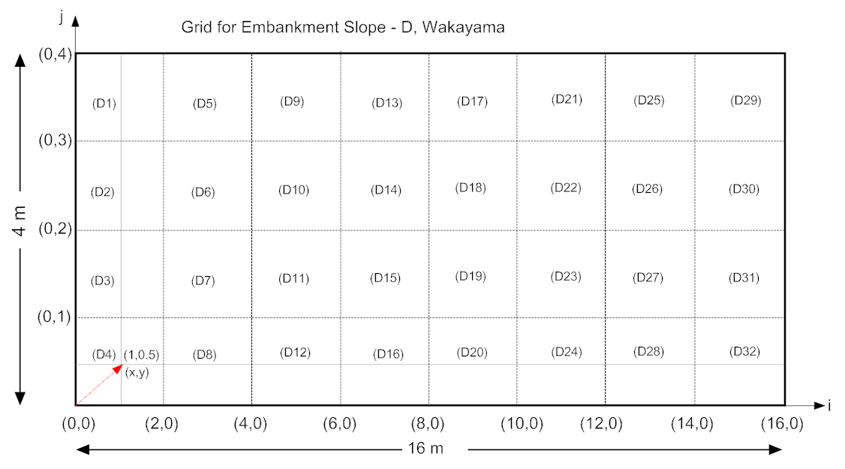
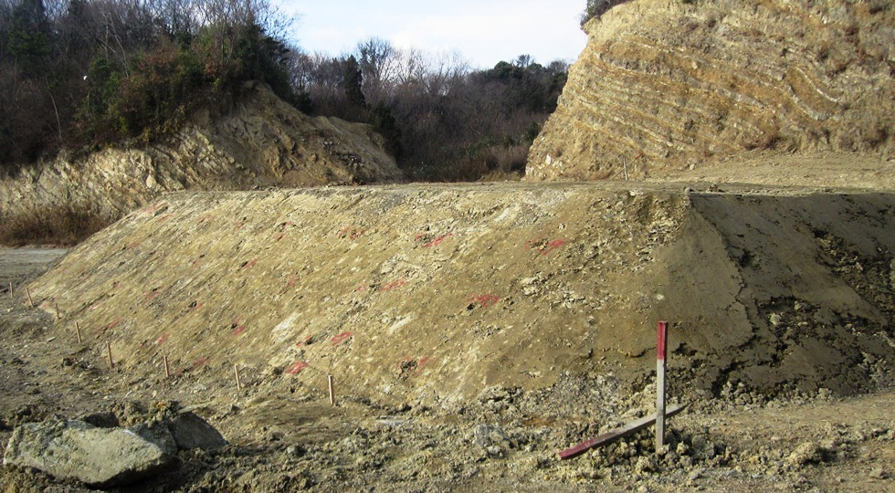
Embankment Site
Iwade Shi
Wakayama Prefecture
Slope-D
The embankment was built with a Smooth Roller Compactor.
Slope was built with a Bucket of excavator.

Slide 5
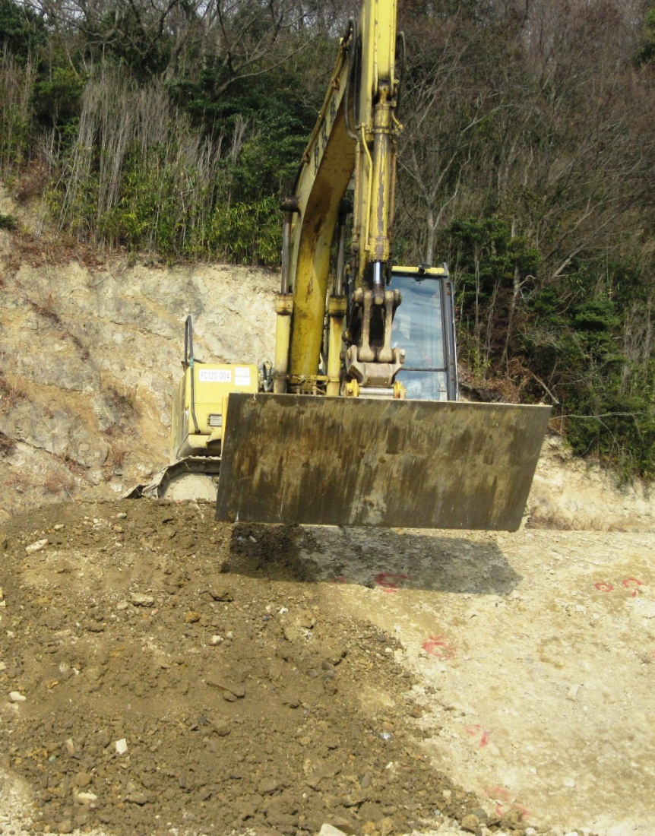
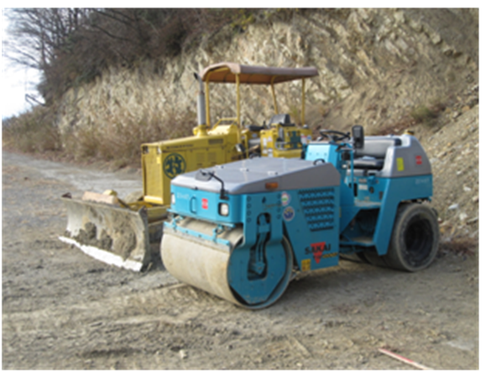
Compaction Devices
Komatsu PC 120-6 Excavator
TW500W-1 Sakai Smooth Roller Compactor

Slide 6
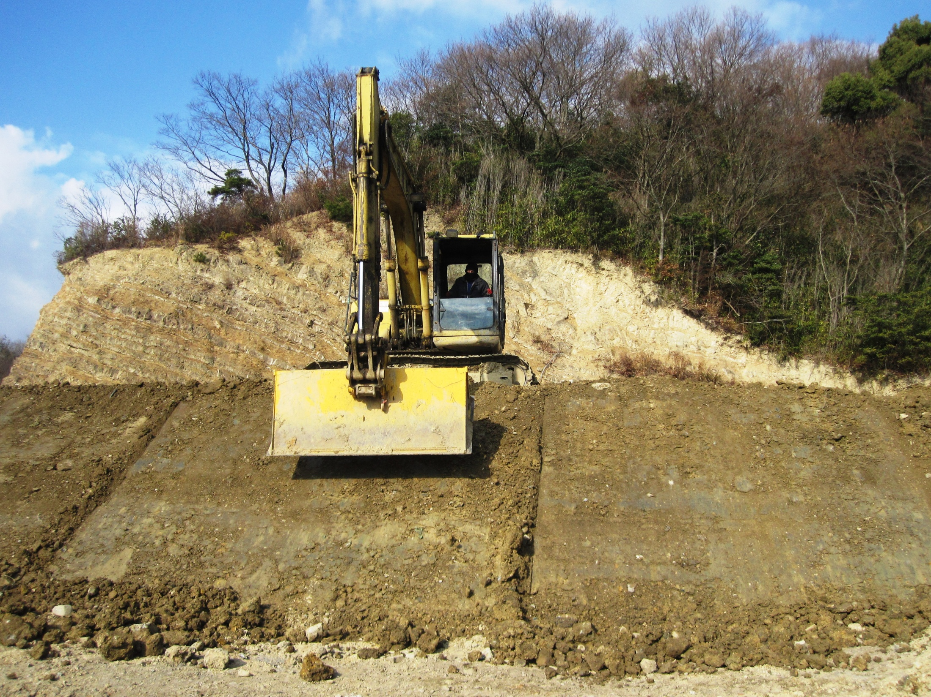
Slope was recreated with increasing number of tamping blow
8 Passes
X
Z
Y
12 Passes
16 Passes
4.2 m
36 blows
48 blows
24 blows
4.2 m

Slide 7
JIS A 1210
JGS 0711
Method of Compaction: E-c
Preparation of specimen: Wet
Procedure of compaction: Non repeated
Weight of rammer: 4.5 kg
Height of fall: 45 cm
Blow per layer: 92
Number of layer: 3
JGS classification | GFS
U_{c} | 393.94
D₅₀, mm | 1.0
ρ_{dmax}, g/cm³ | 1.975
w_{opt}, % | 8.5
w, % | 18.3

Slide 8
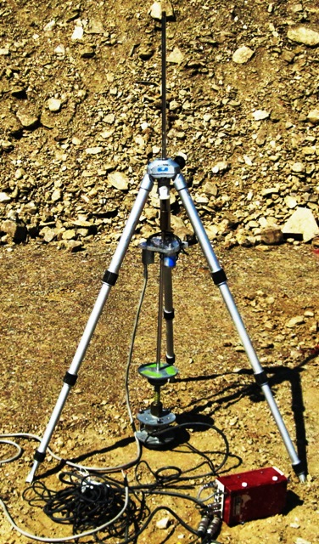
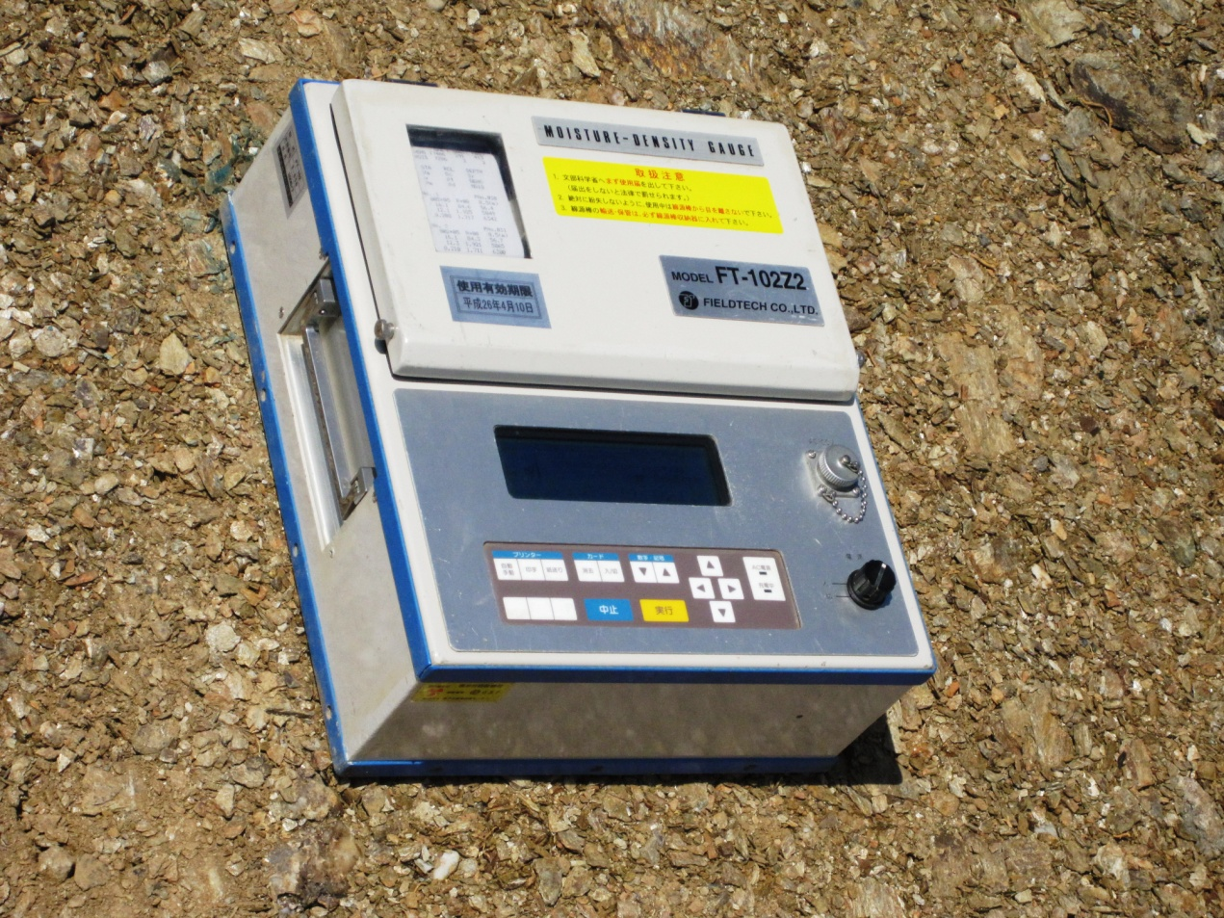
Field Equipment
Moisture Density Gauge (RI)
Falling Weight Defletometer (FWD)

Slide 10
Triangulation Model
The Triangulation model shows that higher water content decreases stiffness for the same degree of compaction.

Slide 11
Phase 2
Results of Modified Second Embankment
Objective
Assess the quality based on time effect monitoring and settlement with changing number of tamping blows

Slide 12
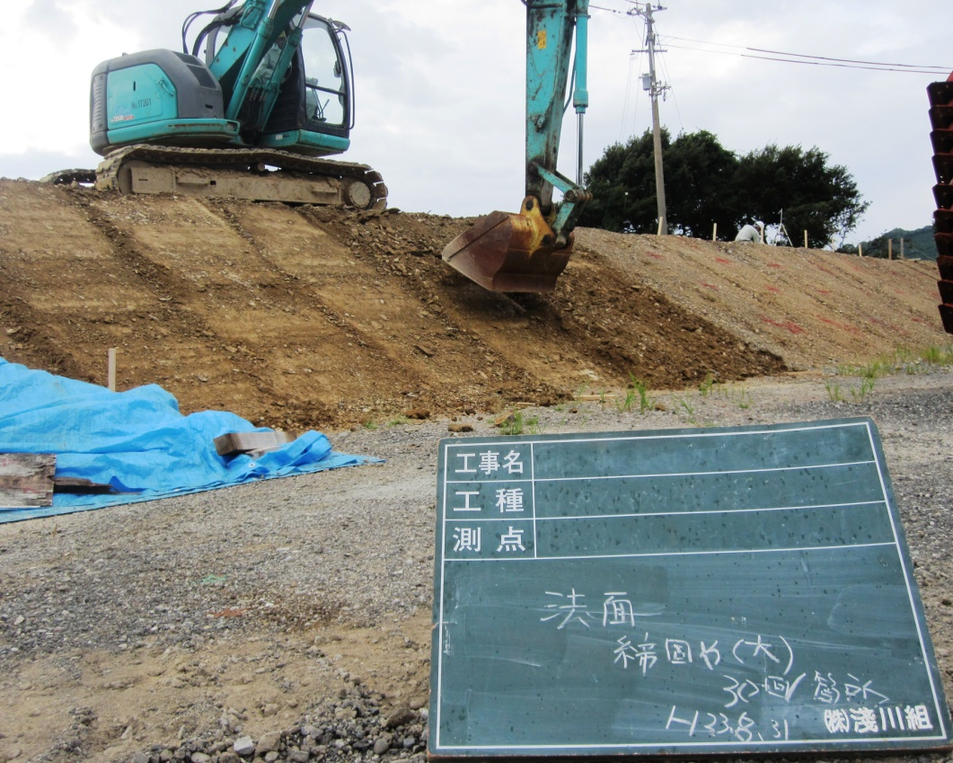
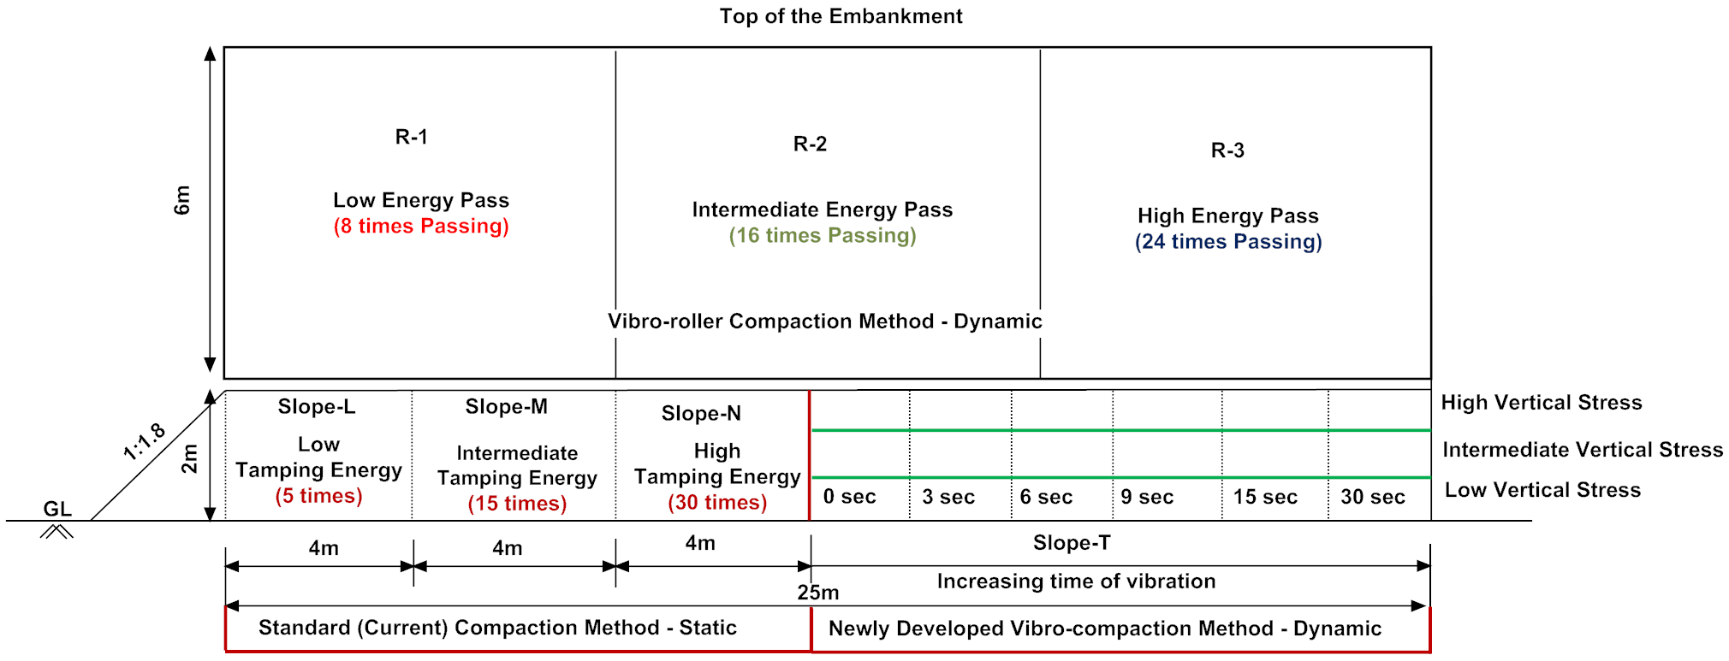
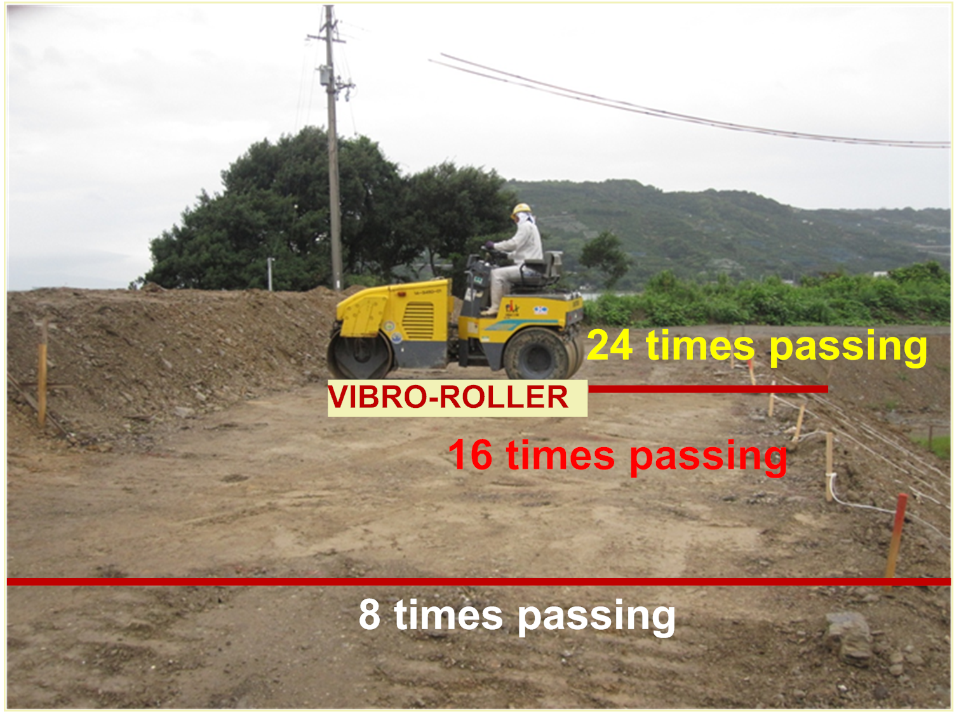
New and Modified Embankment
Kainan Shi
Wakayama Prefecture
M
N
L
15 Blows
30 Blows
5 Blows
BUCKET-TAMPING
R3
R2
R1

Slide 13
Material Property
Local natural soils with rock fragments
JIS A 1210
JGS 0711
Method of Compaction: E-c
Preparation of specimen: Wet
Procedure of compaction: Non repeated
Weight of rammer: 4.5 kg
Height of fall: 45 cm
Blow per layer: 92
Number of layer: 3
JGS classification of soil | GFS
U_{c} | 942.9
D₅₀, mm | 1.3
ρ_{dmax}, g/cm³ | 2.03
w_{opt}, % | 8.7
Natural water content, w, % | 13.65

Slide 14
Pre-molded embankment slope
Sectional and plan view of pre-molded embankment slope
Grid were made for pre-molded slopes for data measurement

Slide 15
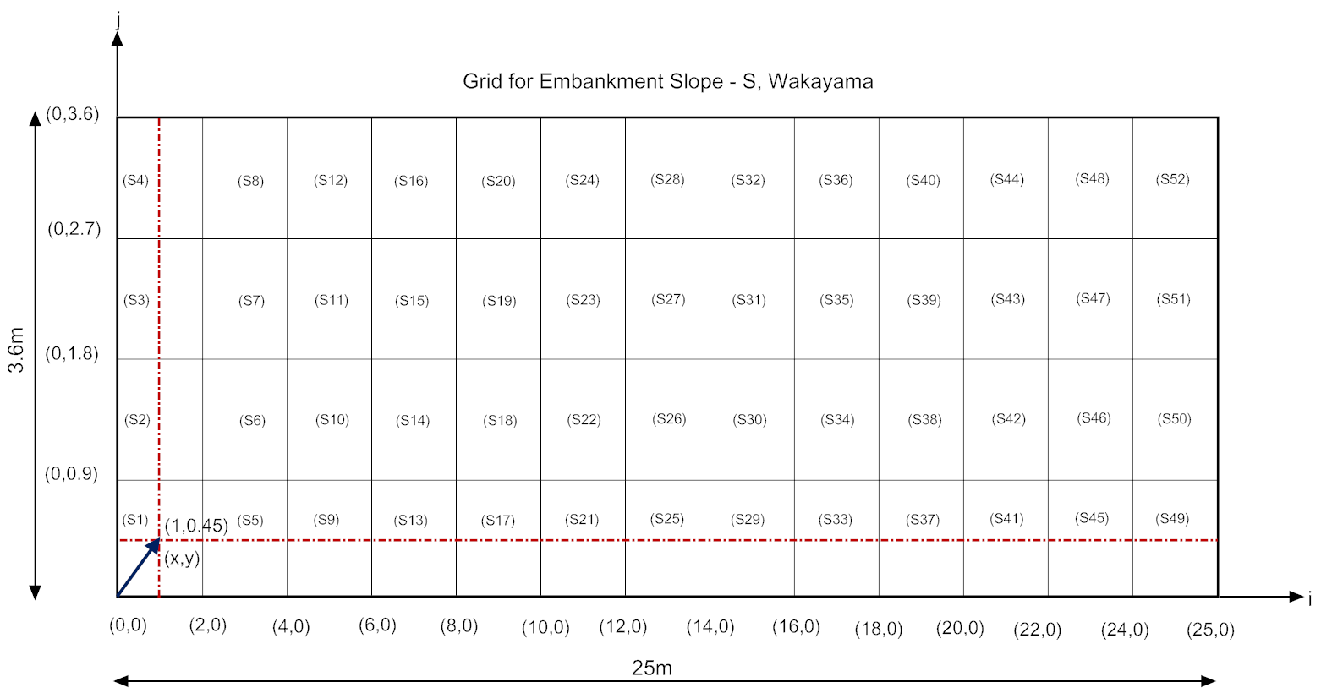
Grid to measure pre-molded embankment slope

Slide 16
Static Compaction
Bucket Tamping Method
  Slope-L: 5 uniform blow of tamping
  Slope-M: 15 uniform blow of tamping
  Slope-N: 30 uniform blow of tamping
  Grid were developed to perform the tests of soil stiffness (FWD), dry density (RI), and sampling (Water content)

Slide 17
Highly scattered D_{c} lied under 95%; maximum in between 80-85 %.

Slide 18
Averaged degree of compaction lies in between 80-90%.

Slide 19
Relative Compaction (RC): 95 %
RC: 90 %
(9.1%)
(9.2%)
RC: 80 %
(w_{av}= 8.8 %)
w_{av}= Average water content
Slope-L: Number of Tamping Blow = 5
Slope-M: Number of Tamping Blow = 15
Slope-N: Number of Tamping Blow = 30
Averaged relative degree of compaction increases from 82-88%.

Slide 20
w_{av}= Average water content
Slope-L: Number of Tamping Blow = 5
Slope-M: Number of Tamping Blow = 15
Slope-N: Number of Tamping Blow = 30
(9.1%)
(9.2%)
(w_{av}= 8.8 %)
Average soil stiffness slightly increased.

Slide 21
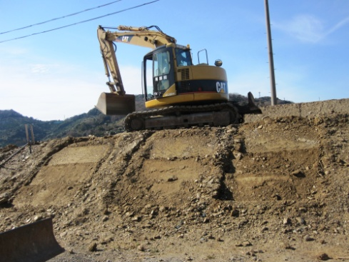
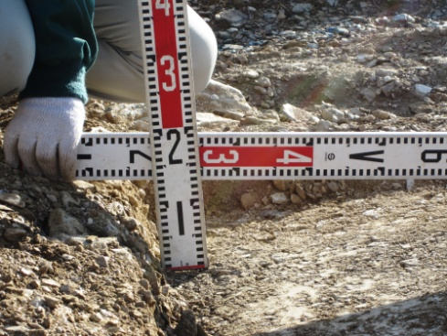
L
5回
M
15回
N
30回
L2
12回
M2
24回
N2
50回
New slopes
Settlement

Slide 22
H=50 cm
Height of tamping
W_{opt} = 8.7 %
W_{opt} = 8.7 %
Increasing degree of compaction increased stiffness.

Slide 23
w_{av}= Average water content
Relative Compaction (RC): 95 %
(w_{av}= 6.6 %)
(10.6 %)
(10.7 %)
RC: 90 %
RC: 80 %
R-1: Number of Passing = 8
R-2: Number of Passing = 16
R-3: Number of Passing = 30
Average dry density improved in between 90-95%.

Slide 24
Monitoring as a Time Effect
Quality improves with negligible fluctuations of water content.

Slide 26
Rainfall decreased stiffness and degree of compaction.

Slide 27
Settlement Before Rainfall
今回の代わった載り面
前回の条件
L’: 12回
M’: 2４回
L
5回
M
15回
N
30回
N’: 50回
L2
12回
M2
24回
N2
50回
January, 2012
Settlement
L2: 12回
Settlement
M2: 24回
Settlement
N2: 50回
s = 9 cm
s = 11 cm
s = 14 cm
s = 9 cm
s = 11 cm
s = 13 cm
s = 7 cm
s = 10 cm
s = 13 cm

Slide 28
Settlement After Rainfall
代わった載り面
前回の条件
L
5回
M
15回
N
30回
L2
12回
M2
24回
N2
50回
April, 2012
Settlement
L2: 12回
Settlement
M2: 24回
Settlement
N2: 50回
s = 7 cm
s = 7 cm
s = 8 cm
s = 6 cm
s = 7 cm
s = 7 cm
s = 7 cm
s = 6 cm
s = 6 cm

Slide 29
Maximum 14 cm settlement achieved about 90% degree of compaction during bucket tamping method.

Slide 30
Rainfall decreased less than 90% degree of compaction and stiffness during bucket tamping method after rainfall.

Slide 31
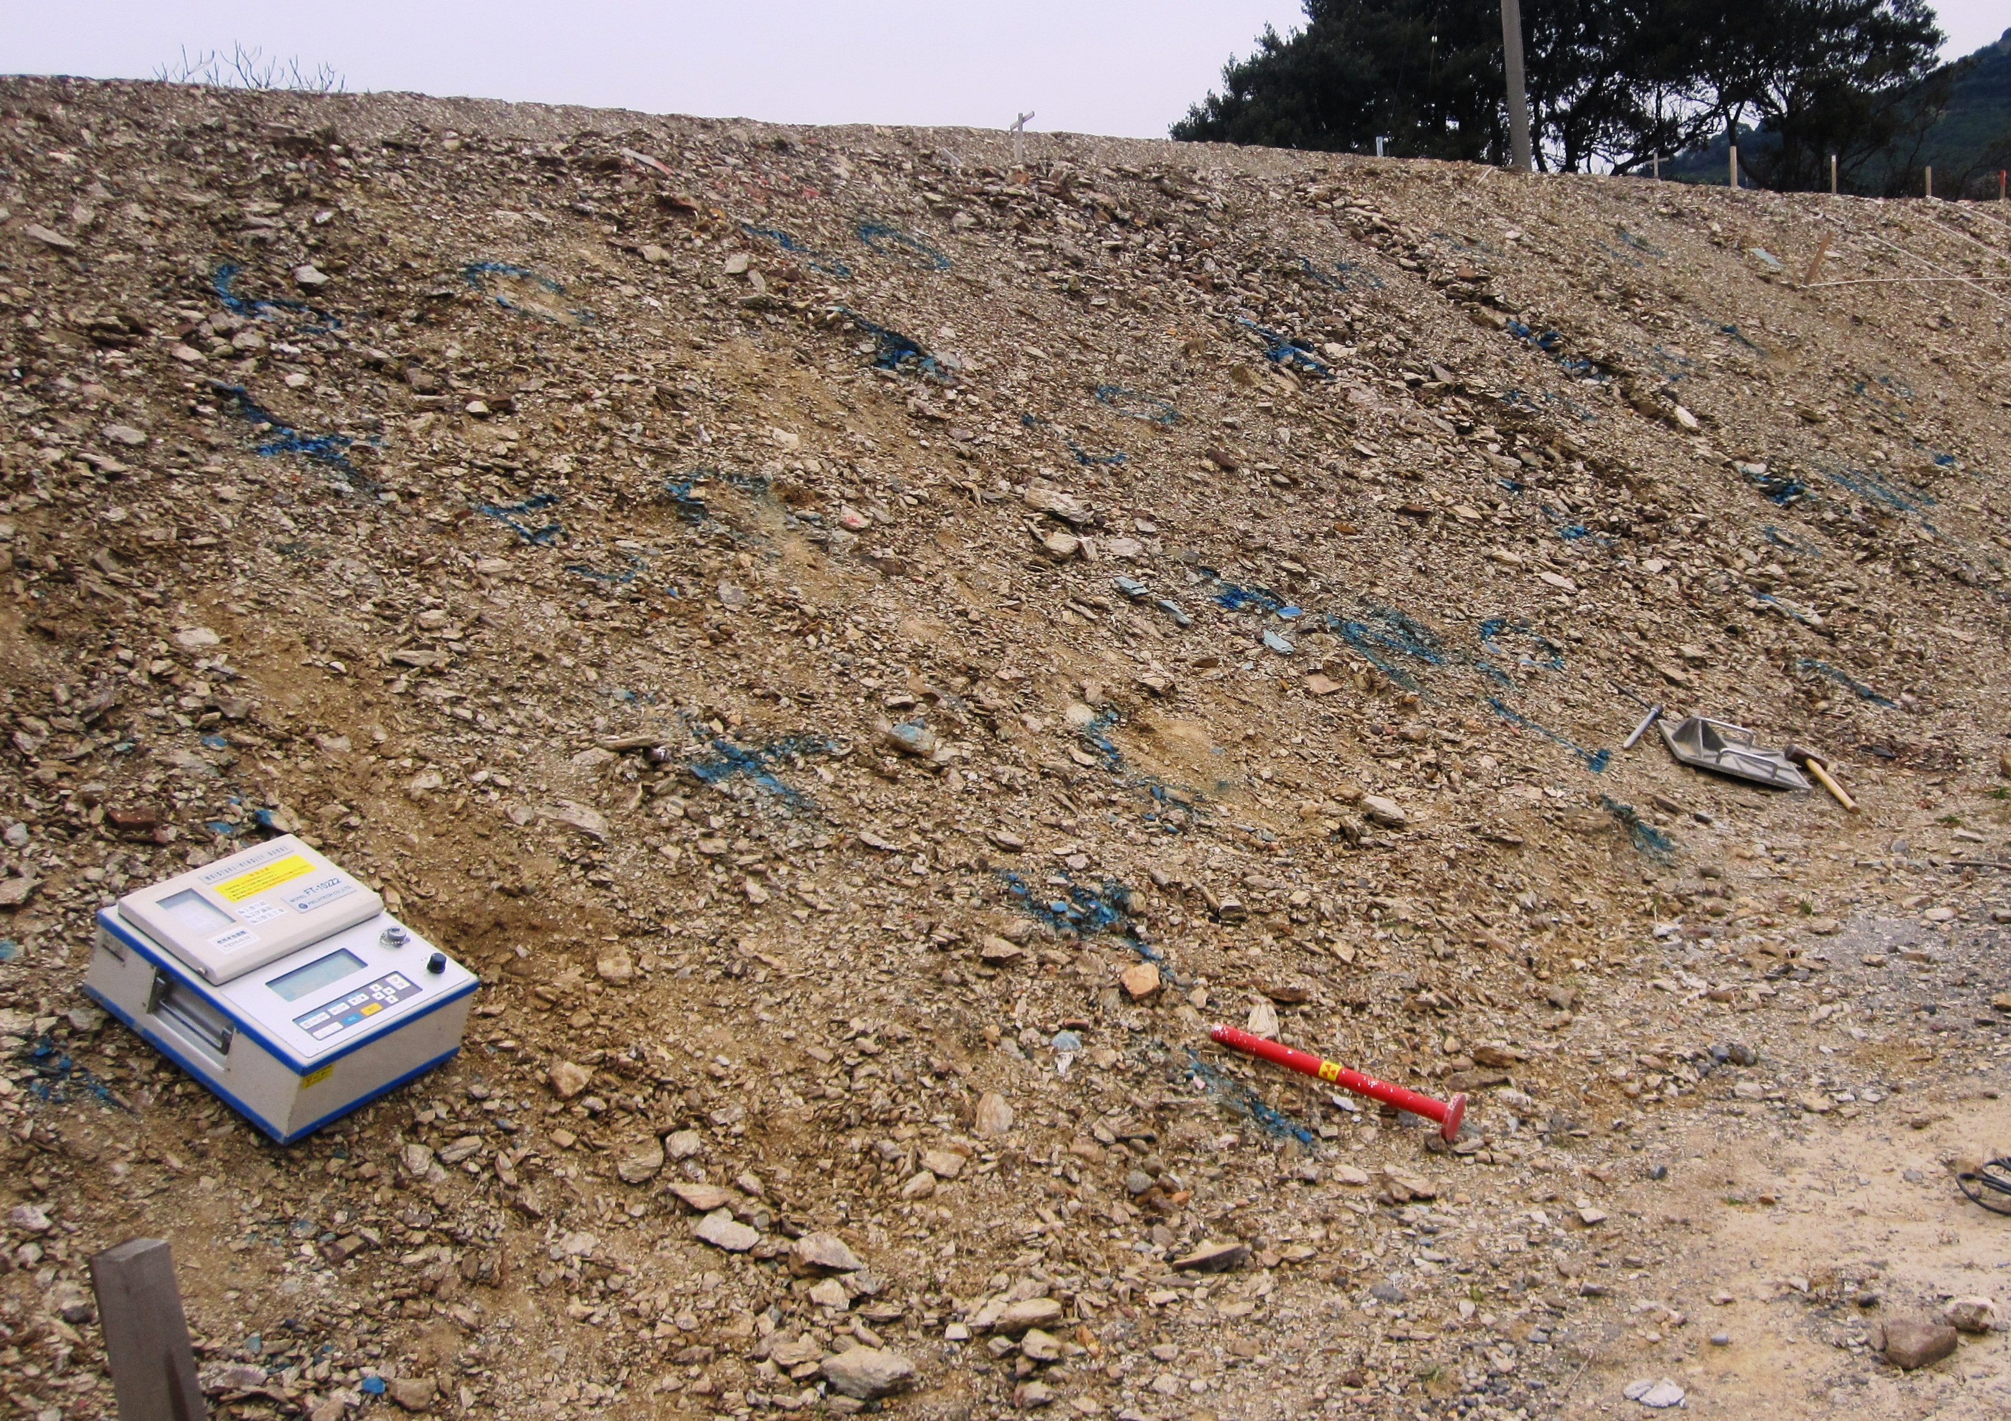
Why D_{c} and K_{f} decreased?
Due to lack of adequate knowledge on engineering geological characteristics of materials used for the construction.
Phyllite
Phyllitic rock particles affect the degree of D_{c} and K_{f} even with slight rain trickles.

Slide 32
Conclusions
Monitoring of slopes and top of the embankment show the increase in degree of compaction and soil stiffness.
The degree of compaction increased near dry side of the optimum water content.
Near or more than 90% degree of compaction can be achieved if half of the total thickness of soil layer is settled down during bucket tamping method.
The Triangulation model shows that higher water content decreases stiffness for the same degree of compaction.
Phyllitic rock particles affect the degree of D_{c} and K_{f} even with slight rain trickles

Slide 33

Thank You very much
for your kind attention!!!
EGCON-2018,

Slide 34
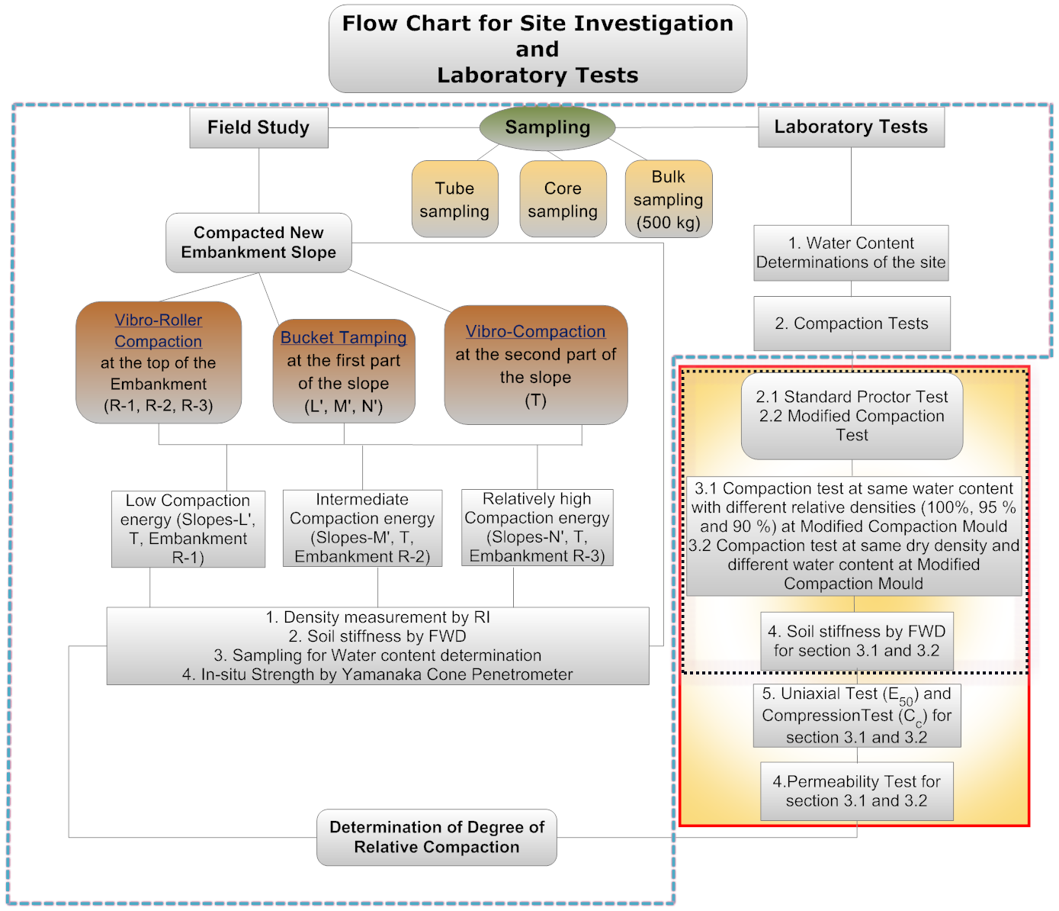

Slide 35
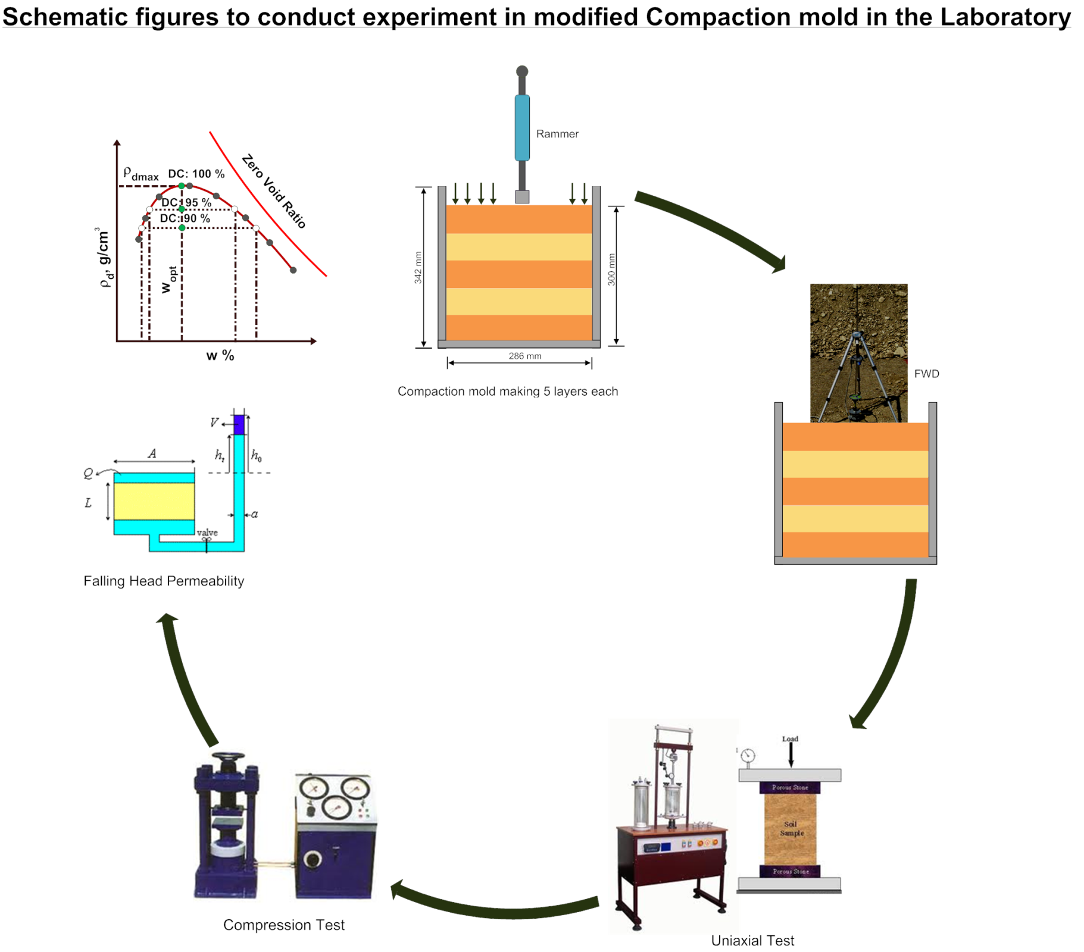

Slide 36
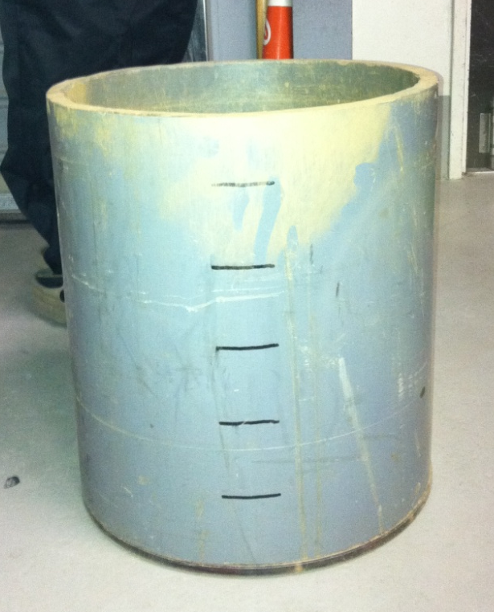

Compaction Mold
Size：4.75mm passing
Diameter of the mold:28.6 cm,
Height of the mold:30 cm
Weight of rammer：4.5 kg
No. of layer：5 layers/1per 6 cm
No. of blow：216/layer
28.6cm
30cm
6cm/layer
Ｅ_{Ｃ}：Energy(kJ/m³)
Ｗ_{Ｒ}：Weight of rammer (kN)
Ｈ：Height of rammer (m)
Ｎ_{Ｂ}：Number of blow
Ｎ_{Ｌ}：Number of layer
Ｖ：Volume of compacted soil (m³)

Slide 37
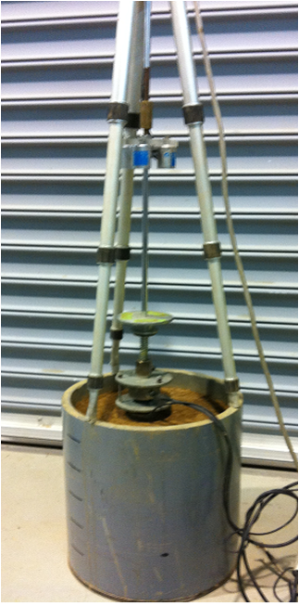
Moisture-Density curve

Slide 38
Results at same water content
ρ_{dmax}:1.88g/cm³
w_{opt}:13.3%

Slide 39
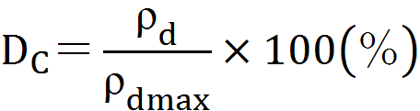
Coefficient of FWD variation on moisture-density curve
ρ_{dmax}:1.88g/cm³
w_{opt}:13.3%
FWD係数=1000
FWD係数=500
Stiffness and compaction can be increased with increasing compaction energy.

Slide 40
Preliminary Site Investigation and its Results
New and Modified Embankment
Innovation of New Devices
1
Phases
2
3

Slide 41
Phase 3
Innovation of New Device
Objective
Develop a new device based on different compaction methodology and make able to innovate Real Time Measurement System

Slide 42
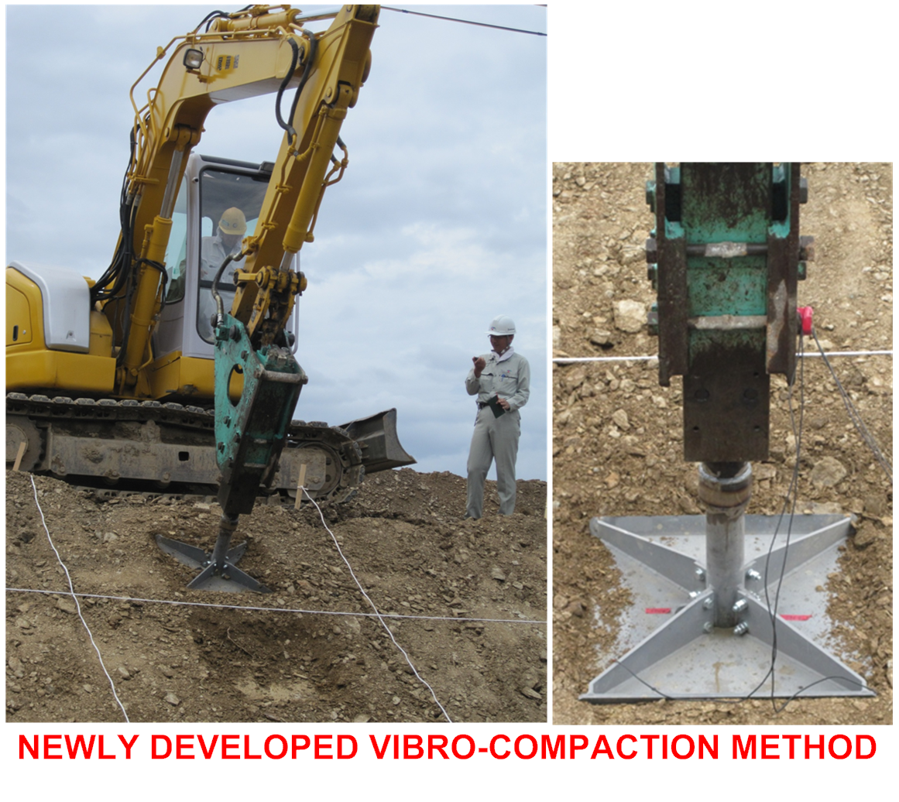
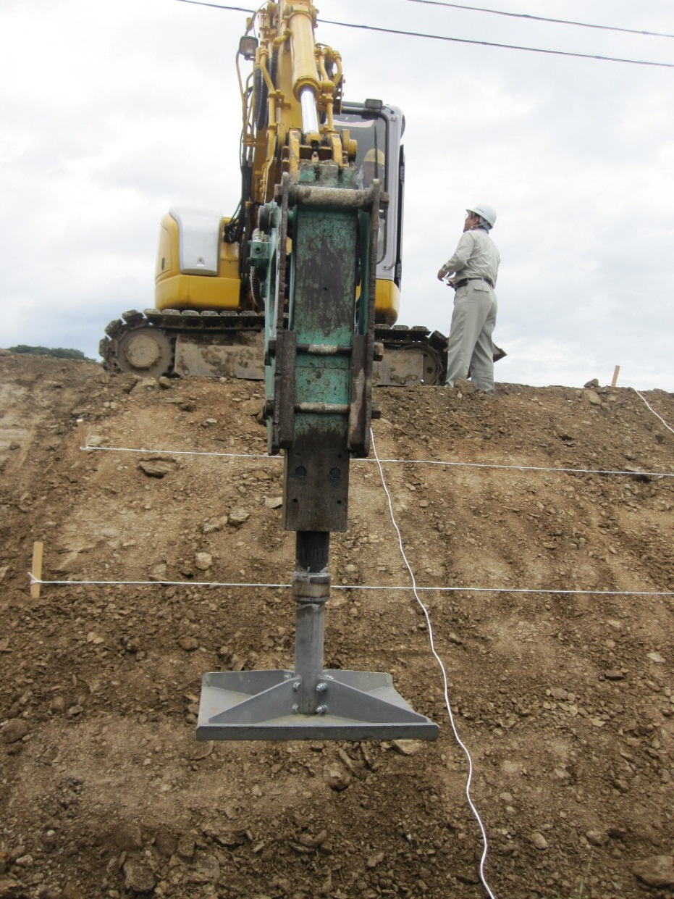
New Devices
50 cm
80 cm

Slide 43

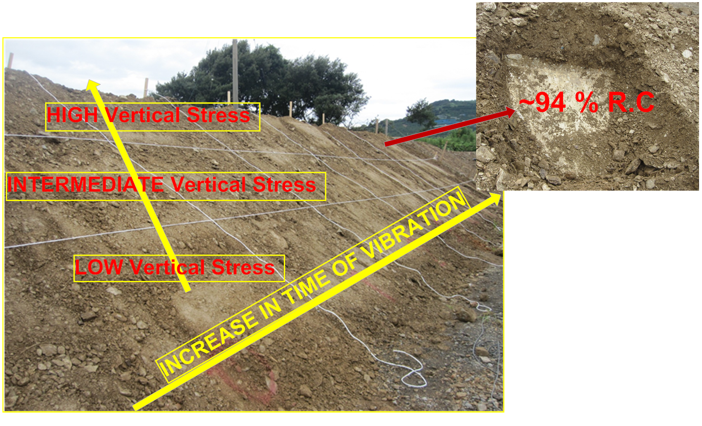
Vibro-Compaction Method
Time (sec)
0 s
3 s
6 s
9 s
15 s
30 s

Slide 44
Results
High compaction with high stiffness lies in between 6s &15 s vibration time.

Slide 45
With increasing duration of vibro-compaction in the slope, dry density increases.

Slide 46
Innovation of Device for Static compaction

Slide 48
Installation of pressure cells and results on recreated slopes

Slide 52
Expected line of pressure increment

Slide 53
Expected line of pressure increment
Average pressure distribution for slopes. Pressure is expected to be increased with increasing compaction energy.

Slide 54
(84.7 %)
(83.9 %)
(82.8 %)
Expected line of pressure increment
Average pressure distribution with increasing tamping energy with expected increment trend of pressur with increasing compaction energy.

Slide 55
Future Strategy
Innovate laboratory scale compaction device

Slide 56
Future Strategy
Innovate laboratory scale compaction device

Slide 57
Conclusion of Phase 1
The Triangulation model shows that higher water content decreases stiffness for the same degree of compaction.
Preliminary Site Investigation and its Results

Slide 58
Conclusion of Phase 2
Monitoring of slopes and top of the embankment show the increase in degree of compaction and soil stiffness.
New and Modified Embankment
Conclusion
The degree of compaction increased near dry side of the optimum water content.
Near or more than 90 % degree of compaction can be achieved if half of the total thickness of soil layer is settled down during bucket tamping method.

Slide 59
Conclusion of Phase 3
Conclusions
Vibro-compaction shows that higher degree of compaction and stiffness can be achieved in between time interval of 6 seconds and 15 seconds.
Innovation of New Device

Slide 60
Thank You very much
for your kind attention!!!

